Slide 1

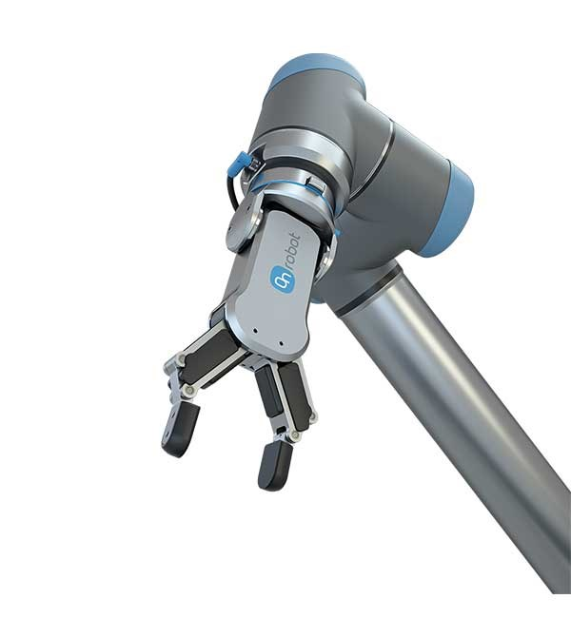
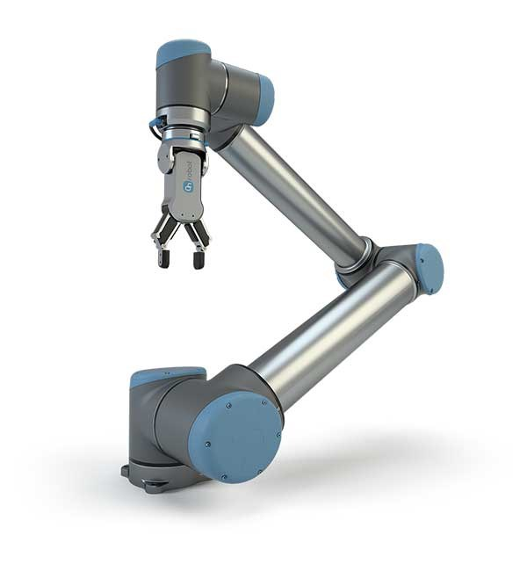
Group 1
Lars Bach Sørensen (S235648) ,
Lasse Manicus (S235655),
Marius Millington (S235659)
INDUSTRIAL PROGRAMMING

Slide 2
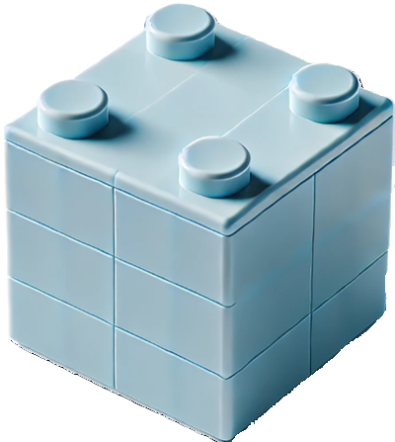
Group 1
Lars Bach Sørensen (S235648) ,
Lasse Manicus (S235655),
Marius Millington (S235659)
TOY FACTORY
INDUSTRIAL PROGRAMMING

Slide 3
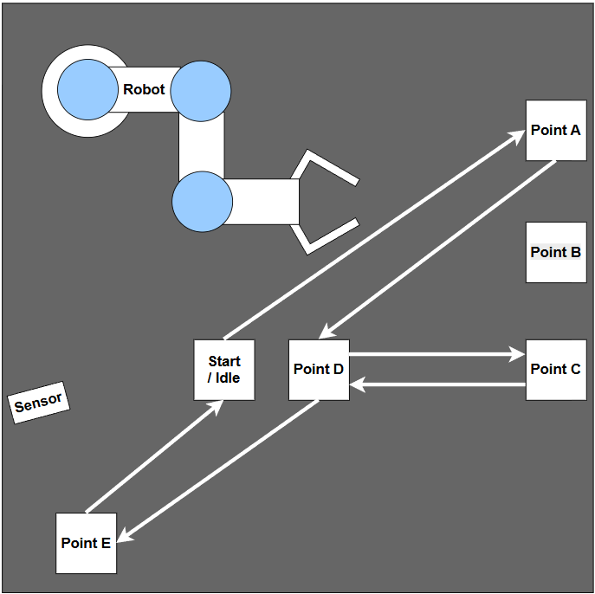
Introduction / Problem (Scope)
Project context
Automated assembly prototype for a toy box factory
Developed as part of the Industrial Programming course
Focus on integrating software, database, and an industrial UR robot
Project objective
Convert digital production orders into deterministic robot motion
Demonstrate end-to-end flow:
GUI → Database → Robot → Database
Ensure predictable, safe, and repeatable robot behavior

Slide 4
Demonstration video
Robot demonstration - Group 1

Slide 5
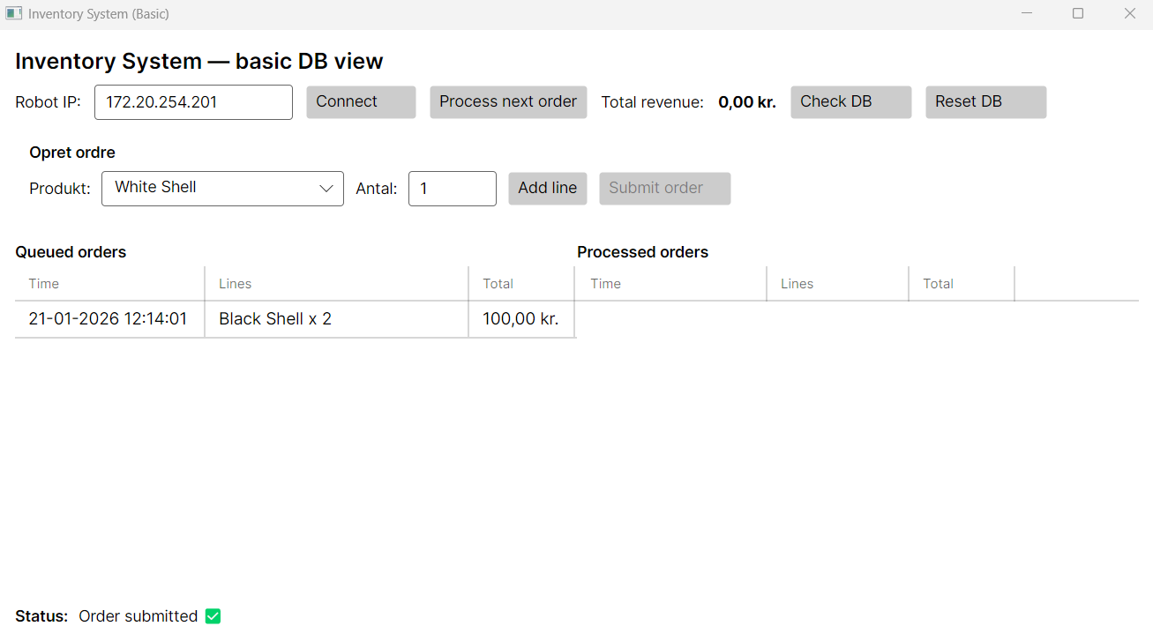
System Architecture
GUI / Operator Station
Create & monitor queue & orders
Start / control production
Application Layer (Control Logic)
Reads next queued order
Maps order → predefined robot sequence
Executes robot + update DB
Data Layer (EF Core + SQLite)
Orders (Queued / Processed)
Persistent system state
Robot Integration Layer
URScript via TCP/IP
Centralized motion sequences & positions
Production flow:
Operator (GUI)
SQLite Database
Application Logic
UR Robot
GUI Update
Design Principles
Single source of truth: Database
Clear separation of layers
Traceability & restart safe operation
Robot logic decoupled from UI & data

Slide 6
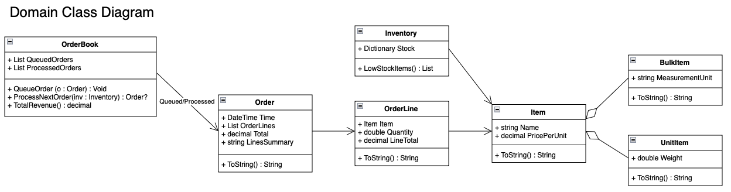
Domain / Inventory
Domain Model – Core Business Logic:
What is produced and in which order, rather than robot assembly. Independent of gui and robot.
Inventory & item
Represents physical components used in production
Inventory = collection of items + quantities
Common item abstraction with optional specialization
Tracks stock an updates when orders are processed.

Slide 7
Domain / Inventory
OrderBook & Order States
Central production flow controller
Two states
Queued Orders (pending)
Processed Orders (completed)
Characteristics
Operator choice: the GUI lets the operator compose an order (White/Black shell lines) and submit it.
Queue rule: once submitted, orders are queued and executed FIFO.
Traceability: queue/processed state is stored in the database (single source of truth).

Slide 8
Domain / Inventory
Design Rationale
Domain logic isolated from UI and robot execution
Operator control improves transparency, safety, and testing
Deterministic execution with option for future automation
Result:
A simplified but realistic production control model combining
human supervision + data-driven automation
Order Model
Order = timestamp + list of OrderLines
OrderLine = item + quantity
Supports multi-item orders and future product expansion
Technical Example: Process Next Order -> Boolean (order queued condition)-> if else (stop or continue) -> Loop (based on quantity). Strings for items (reference text)

Slide 9
Database Design
Data Flow & Consistency
All orders, inventory data, and production state are stored in the database
Application logic reads this data and translates it into robot motion sequences.
Database Technology and Access
Ensures consistency between GUI, Application logic
and physical robot execution.
SQLite
Operator controlled system (Human vs full automation)
Entity Framework Core to persist production state
Seeding & Reset

Slide 10
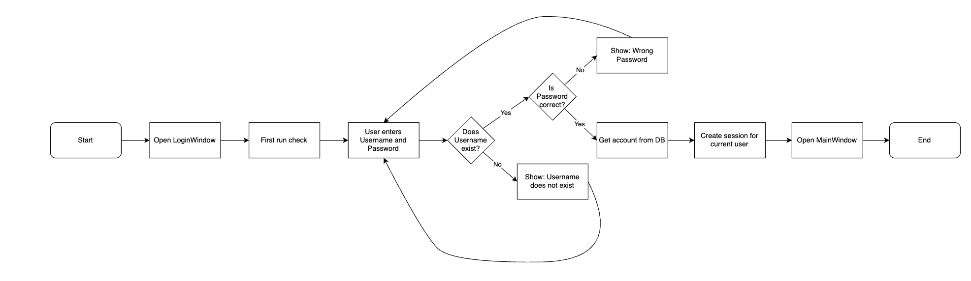
Security
Login feature
Database controlled
Has multiple verification levels
  Does Username exist
  Is password correct
Creates a session for the logged in user
Password Salting
The system uses salting in database
Protects against precomputed attacks like Rainbow table

Slide 11


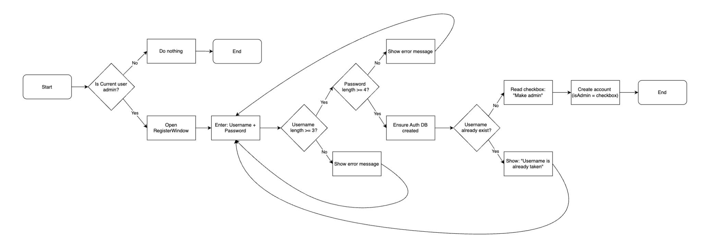
Security
User
Admin User
Create User (Admin)
Create new user is limited to admins
Account requirements
  Username length => 3?
  Password length => 4?
Option to make admin
Creates account in database

Slide 12
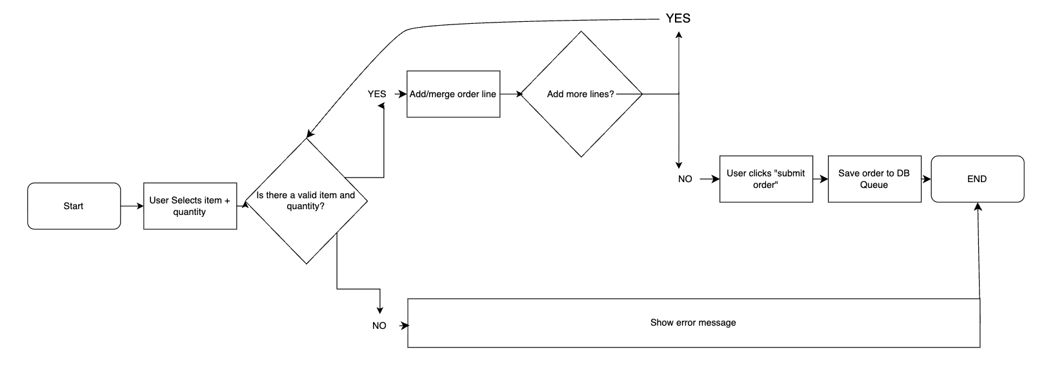
GUI and ViewModel (MVVM)
Interactive GUI able to both create orders and process orders.
Create order
User able to select both item and quantity
The order is first validated by the system
Database stores as a queued order
  Database becomes single source of truth

Slide 13
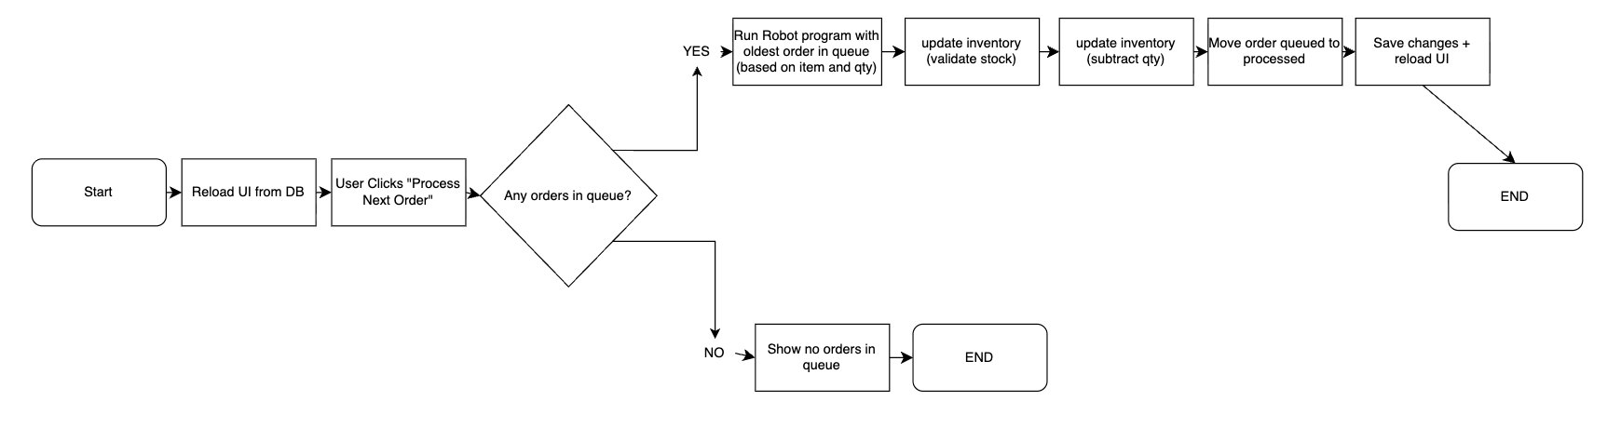
GUI and ViewModel (MVVM)
Interactive GUI able to both create orders and process orders.
Process order
Process Next Order retrieves oldest queued order in database
The order is translated to the robot
When robot is done - Database is updated
  Inventory updated
  Queued → Processed
Continuous status messages are displayed to inform the operator

Slide 14
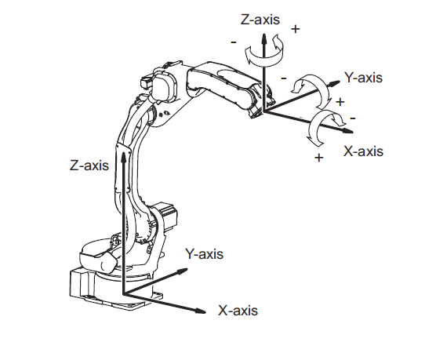
Robot Integration
GUI
Database driven
Orders created in GUI
Stored in Database
Communicating via
URScript → TCP/IP → Ethernet → Robot
Connects to URSim & real robot
Database
URSim
Positioning
Start position (Tool Center Point)
  X = 0.125
  Y = - 0.300
  Z = 0.100
Start rotation (Tool Center Point)
  RX = 3.14 (180° nedad)
  RY = 0.00
  RZ = 0.00

Slide 15
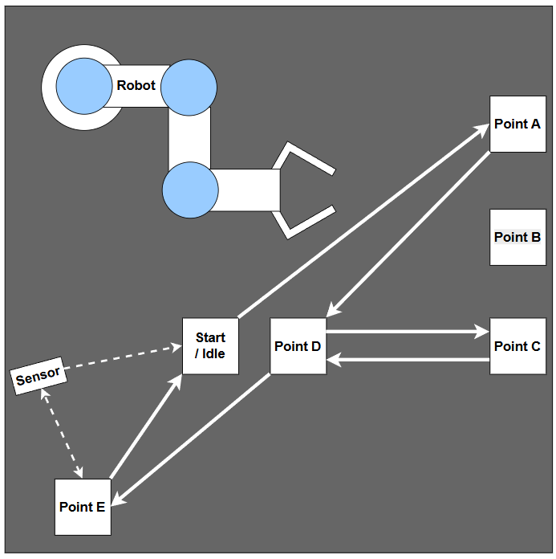
Robot Integration
Robot motion structure
  Determined motion from A→E
  Using Move L
Pick & place - Height
  Gripper - RG2
    open_mm = 60
    open_pick_mm= 85
    close_mm = 31
    f_open = 30
    f_close = 30
Predefined predictable sequences

Slide 16
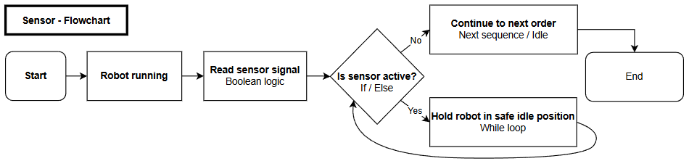
Sensor (Safety)
Why safety is needed?
  Due to human interaction
  Error minimizing in production loop
Sensor
  Photoelectric
  Detects products
  Signals robot to wait or proceed
Uses robot logic

Slide 17
Discussion
What worked well
Easy operator-controlling
Stable robot communication
Predictable robot behavior
due to fixed positions
Clear separation between GUI,
database, and robot logic
Easy testing using URSim
Challenges
Robot calibration required significant testing
Fixed positions reduce flexibility
System relies on operator-controlling
Trade-offs
Manual operator control chosen over full automation
Fixed positions instead of vision system
Safety prioritized over production

Slide 18
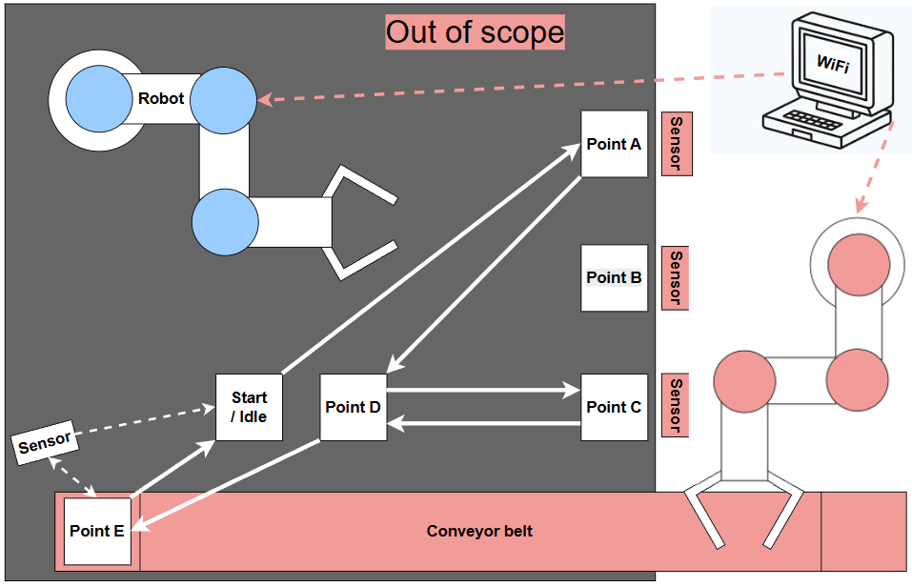
Solution
Future implementation
Minimize human interaction
Robot automatically replenish A, B & C
Conveyor belt moves finished product
Machine vision senses location/size
Functional automated assembly prototype with human interaction
End-to-end digital flow:
  GUI → Database →
  Robot → Database
Modular and maintainable architecture

Slide 19
Conclusion
Project objectives were met
System behaves like a realistic industrial prototype
Demonstrates principles from:
  Industrial programming
  Industry 4.0 & 5.0
  Automation
  Security & safety
  Modular software design

Slide 20
Thank you!

Slide 21
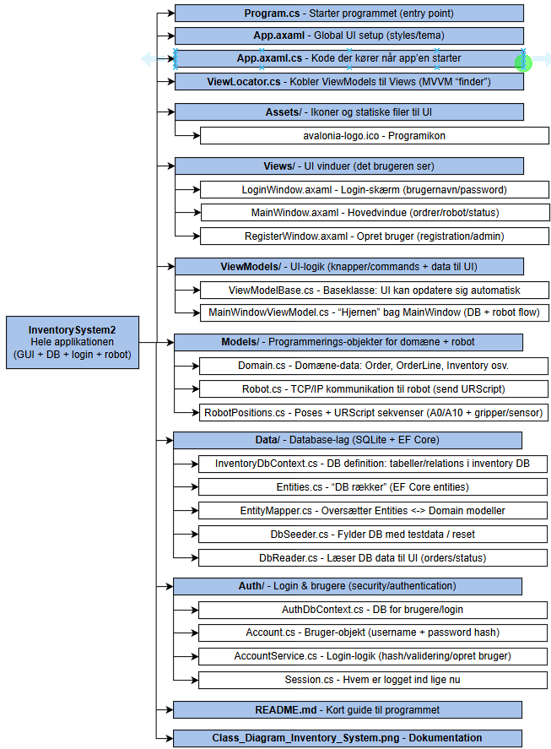
Program overview

